Slide 1




Introduction to
the Flee Workshop
Derek Groen
Gebremariam Assres
Diana Suleimenova
Adama Science and Technology University
July 2019

Slide 2
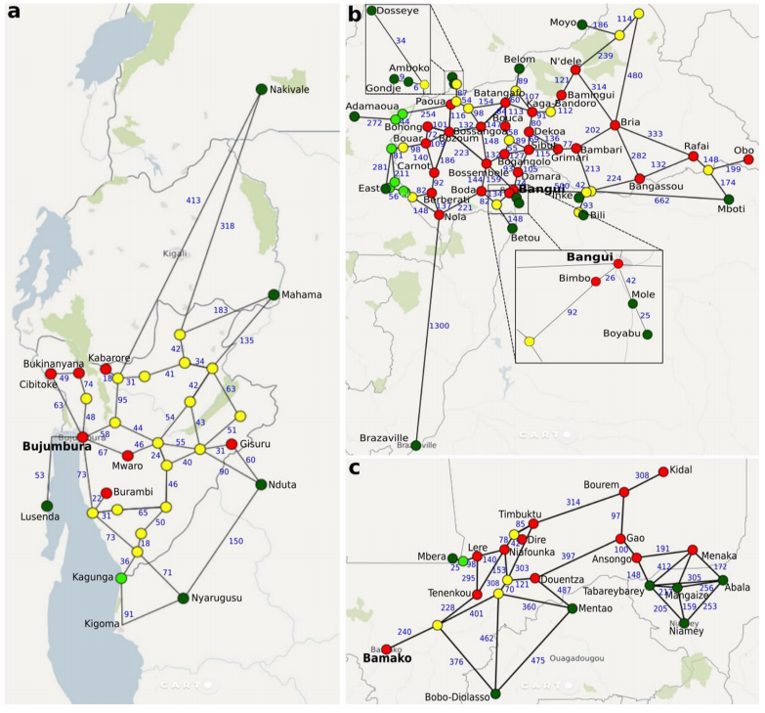
ACTIVITIES
Welcome and introduction of the team
Project and Flee background: why are we here?
What are you going to learn?
Agenda for today and tomorrow
Practical announcements
Notes:
Lecture 50 minutes:, discussion: 40 minutes, hands-on: 75 minutes, break: 15 minutes.

Slide 3
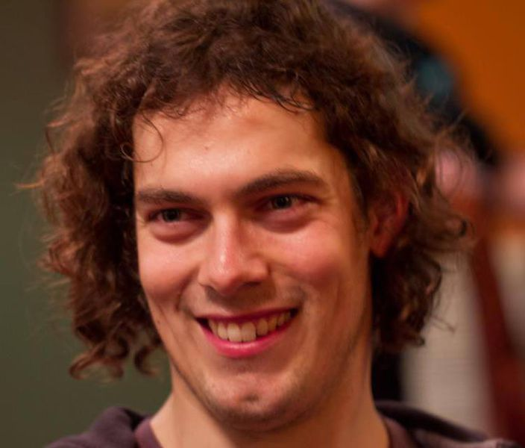
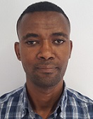
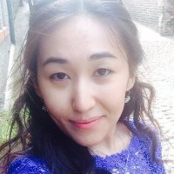
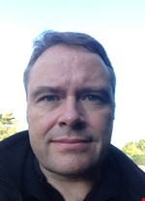
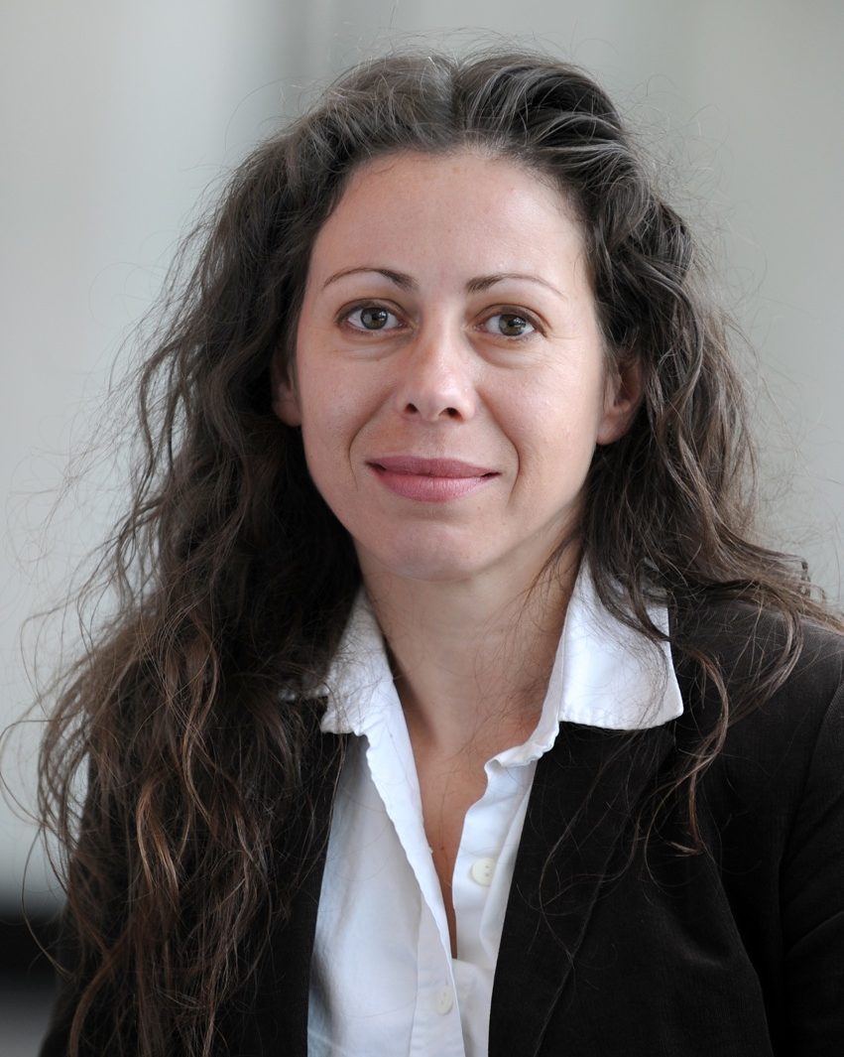
OUR TEAM
Derek Groen
Lecturer in Simulation and Modelling
Gebremariam Assres
Research Fellow - Coupled Agent-based Simulations (HiDALGO)
Diana Suleimenova
Research Fellow - Multiscale Migration Prediction (VECMA)
Simon Taylor and Anastasia Anagnostou
Sci-Gaia Colleagues, contributors, linked us up (!).
Hamid Arabnejad and David Bell
Contributors to VECMA & HiDALGO.
Subam Bista and Qusai Zakir
Student contributors.

Slide 4
OUR EXPERTISE
Simulations across disciplines, including
forced population displacement,
astrophysics,
blood flow,
materials;
Lead developers of the Flee agent-based modelling code, and the FabSim3 toolkit for automating computational tasks using remote resources.
Extensive expertise in model coupling, and high performance computing (see tutorial 3):
e.g. involved in developing the MUSCLE2/3 and MPWide coupling tools.
Active collaborations with UNHCR and NGOs through the SAROBMED consortium.
Two projects (VECMA and HiDALGO) funded by the European Union Horizon 2020 research and innovation programme.

Slide 5
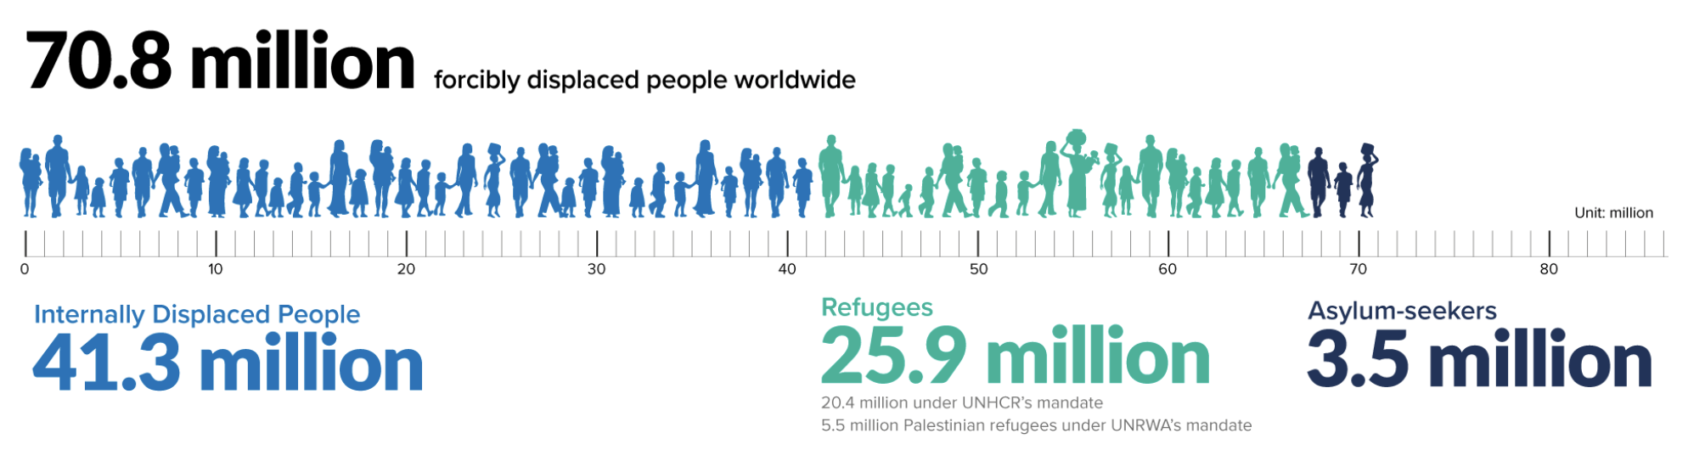
OUR PROJECT
People inevitably attempt to flee from major conflicts, disasters and other life-threatening events.
These forced migration movements have major humanitarian, political, economic and societal consequences.
Plenty of empirical research. Yet, few researchers try to simulate refugee movements.
Why simulate forced population displacement?
To help provide humanitarian aid in the right places, at the right time,
To help complete incomplete data collections on refugee movements,
To estimate the effect of policy decisions (e.g., border closures, camp relocations, forced redirection).

Slide 6
WHY ARE WE HERE?
To teach you about Flee, agent-based modelling, and model building at large.
Learn about:
What kind of things you would like to simulate.
How we can modify and apply our codes to help solve problems/challenges you face.
How we can make our existing simulations more accurate and realistic.
What problems we should be trying to research going forwards.
To meet all of you, and explore how we can work together.

Slide 7
WHAT ARE YOU GOING TO LEARN?
Simulation and modelling:
Agent-based modelling (ABM).
Migration modelling.
Flee simulations.
Developing and prototyping your own ABM code.
High Performance Computing:
Supercomputers.
Code coupling.
Parallelization.
Hackathon: First-hand experience.

Slide 8
AGENDA FOR TODAY

Slide 9
SESSION 1: INTRODUCTION TO FLEE
Flee migration model basics
Agent-based modelling
Key concepts in Flee
Hands-on: Installing and running basic Flee simulations
Break
Migration simulation scenarios
Mali, Central African Republic and Burundi
Current results
Discussion: How to use Flee for the Ethiopian context?
Break
Simulating forced migration in South Sudan
Exploring policy implications using automated ensemble simulations
Hands-on: Using Flee for specific situations
Discussion: How to make these simulations more realistic and accurate?

Slide 10
SESSION 2: DESIGNING AND PROTOTYPING YOUR OWN SIMULATION
More extensive ABM introduction
Agents, location graphs, rules and states, timestep and visualisation
Hands-on: Programming tutorial for the vanilla ABM code 1
Break
Hands-on: Programming tutorial for the vanilla ABM code 2
Break
Hands-on: Programming tutorial for the vanilla ABM code 3
Hands-on: Prototyping your own simulation in preparation of the Hackathon

Slide 11
AGENDA FOR TOMORROW

Slide 12
SESSION 3: MODELLING MIGRATION WITH OTHER THINGS ON SUPERCOMPUTERS
Introduction to supercomputers and parallelized Flee
Coupling Flee to other models
Discussion: Ideas for coupled models
Break
Hands-on: Running the parallel and coupled simulations
The HiDALGO and VECMA projects
Demonstration of Flee on a supercomputers
Break
Introduction to the Hackathon
Hack ideas discussion and write up
Pitch the ideas

Slide 13
SESSION 4: APPLICATION - HACKATHON
Form groups
Hands-on: Hack part 1
Break
Hands-on: Hack part 2
Break
Presentation preparation
Presentations

Slide 14
PRACTICAL ANNOUNCEMENTS

